Slide 1
Who is in the picture AI frameworks
Rayen Ghordo

Slide 2
cONTENTS
Introduction
Detection Workflow
Embedding Generation
Selection of K
Clustering
Model Training

Slide 3
Introduction

Slide 4
Problem 1: inconsistency
No clear labelling rules
Partially visible or unclear faces
→ Inconsistent labels

Slide 5
Problem 2: overlabeling
Hundreds of faces to label
Not all faces are detectable by the model
→ Risk of labelling unusable data

Slide 6
Strategy
Detect & align faces
Face embeddings
Clustering
→ labelled data
Training

Slide 7
Detection workflow

Slide 8
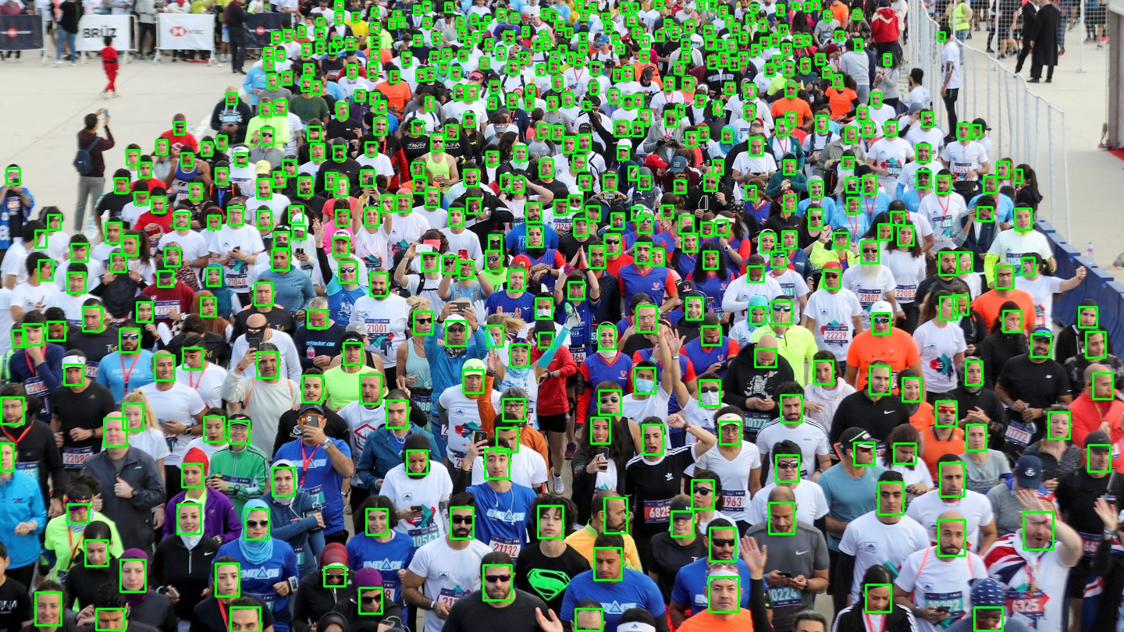
Face detection model selection
RetinaFace
Provided by UniFace
Real world conditions

Slide 9
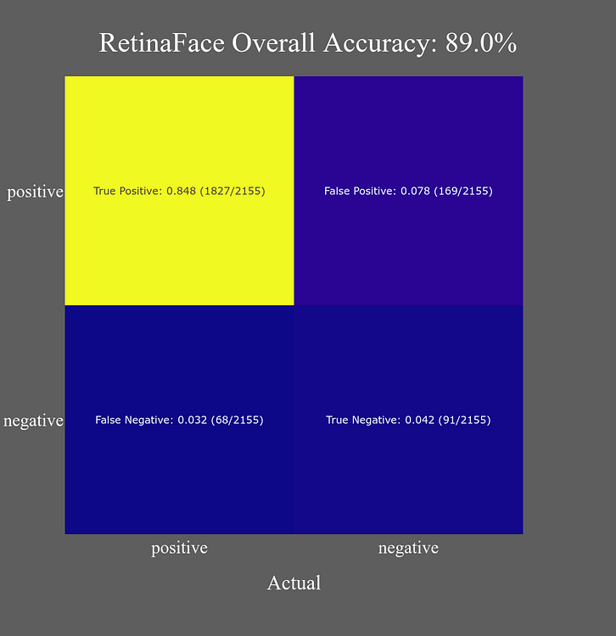
Face detection model selection
Evaluated on a dataset of 1000 samples
High number of true positives
Reliable face detection performance

Slide 10
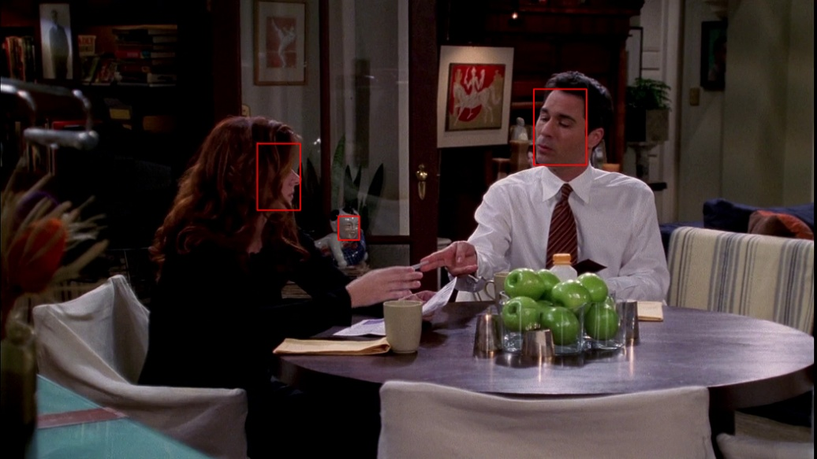
Face detection model selection
RetinaFace is highly sensitive
Can detect non-face regions as faces
Background patterns may resemble facial features
Results in false detections
Confidence threshold & filter based on bounding box size

Slide 11
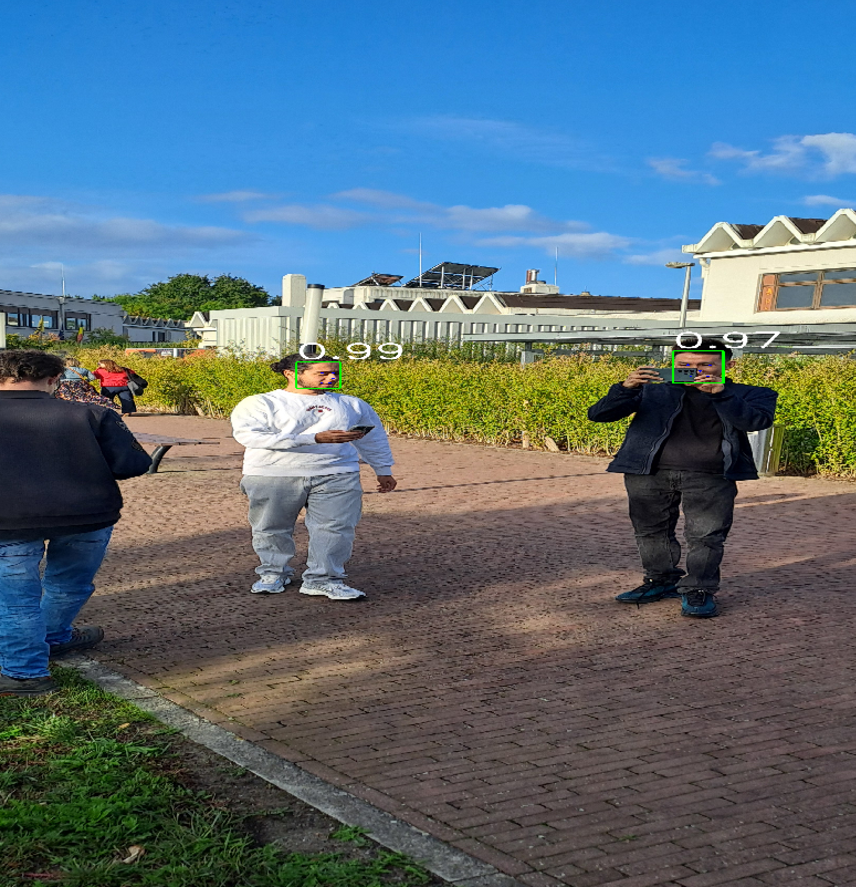
Detection
Images processed one by one
RetinaFace with ResNet-34 backbone
Bounding boxes and confidence scores visualized

Slide 12
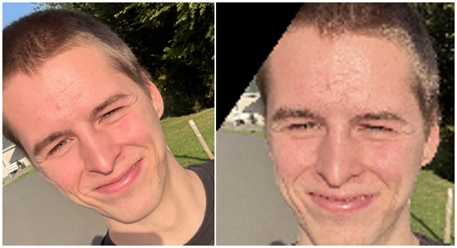
Face Alignment
Faces aligned & cropped
Corrects:
Rotation
Scale
Position
Produces standardized face format
Saved separately

Slide 13
Embedding Generation

Slide 14
Embedding model
Embedding = vector representation facial features
→ embeddings of same person close to each other
ArcFace
Input: aligned face images
Output: embedding vectors

Slide 15
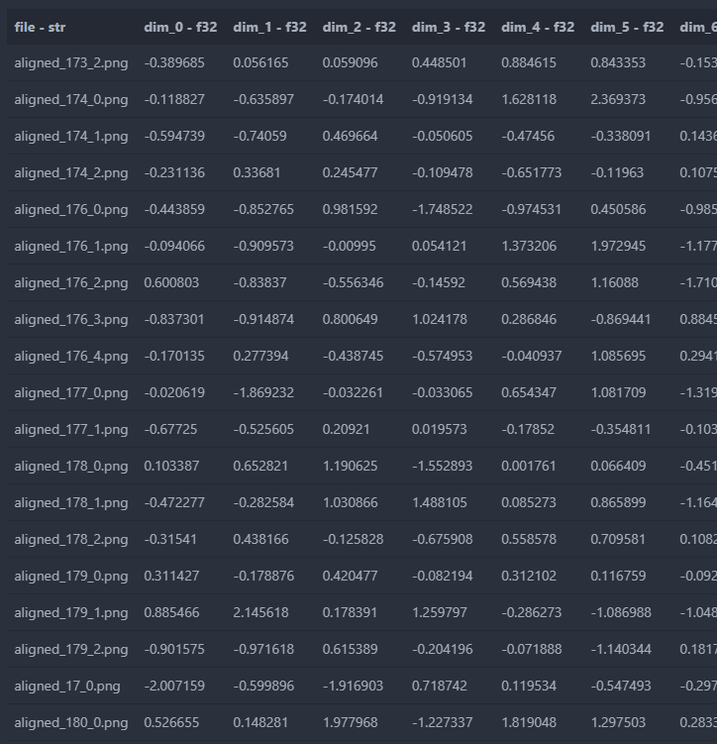
Metadata
Each embedding linked to a face filename

Slide 16
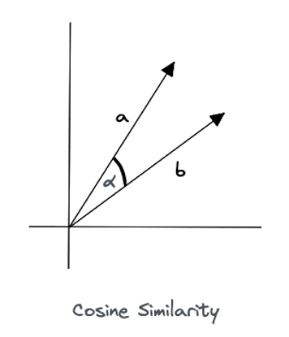
Cosine similarity
Measures angular similarity
Small angle = high similarity
vector direction encodes identity information
→ Classification

Slide 17
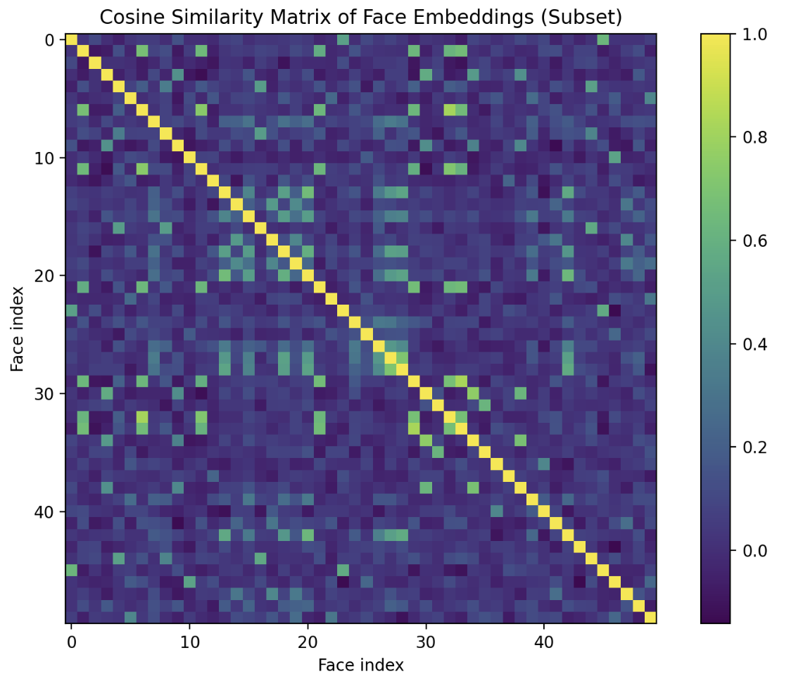

Slide 18
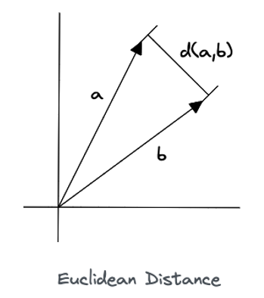
Euclidean Distance
Measures straight-line distance
→ Depends on magnitude and direction
Small distance = high similarity
Used in distance-based algorithms
→ Clustering

Slide 19
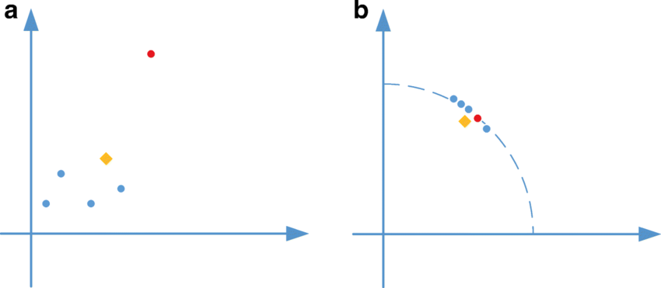
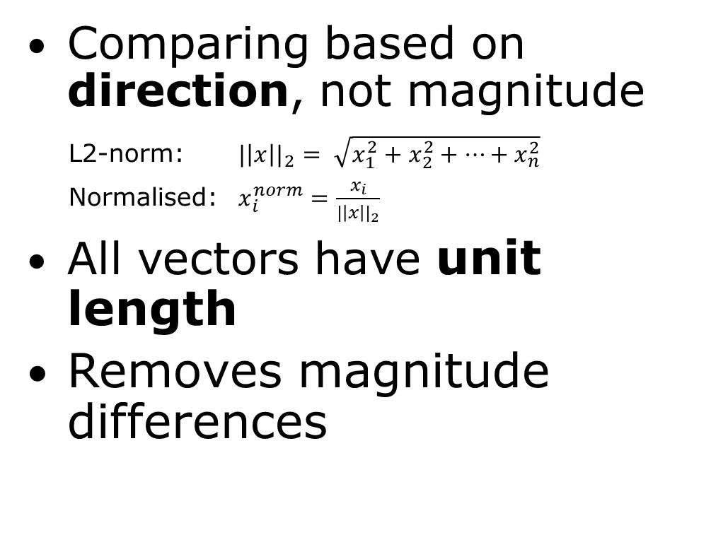
Embedding Normalization
Comparing based on direction, not magnitude
L2-norm: ${|\left|x\right||}_{2}= \sqrt{x_{1}^{2}+x_{2}^{2}+…+x_{n}^{2}}$
Normalised: $x_{i}^{norm}=\frac{x_{i}}{{|\left|x\right||}_{2}}$
All vectors have unit length
Removes magnitude differences

Slide 20
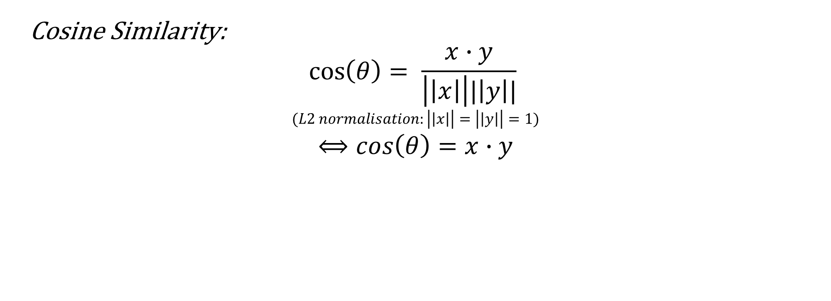
Cosine Similarity:
$$\cos\left(θ\right)= \frac{x∙y}{\left|\left|x\right|\right||\left|y\right||}$$
$$(L2 normalisation:\left|\left|x\right|\right|=\left|\left|y\right|\right|=1)$$
$$⟺cos\left(θ\right)=x∙y$$

Slide 21
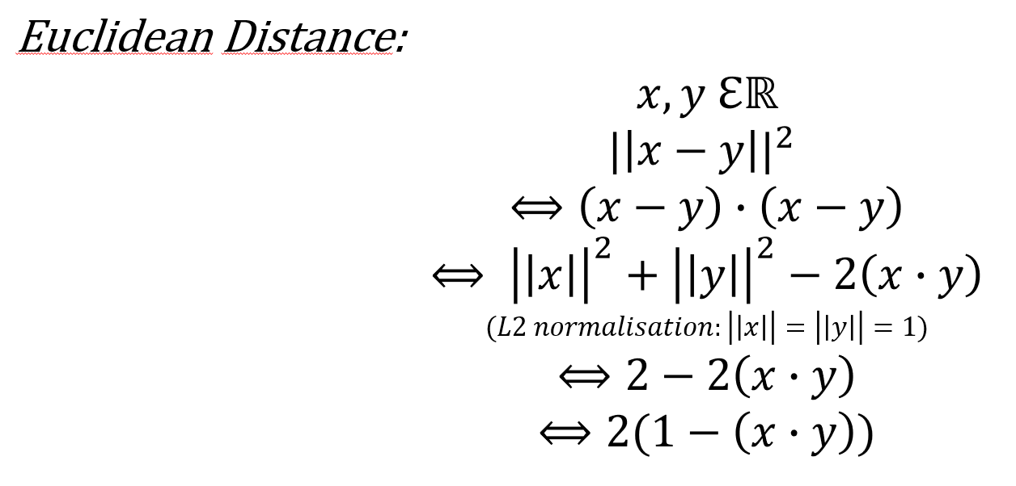
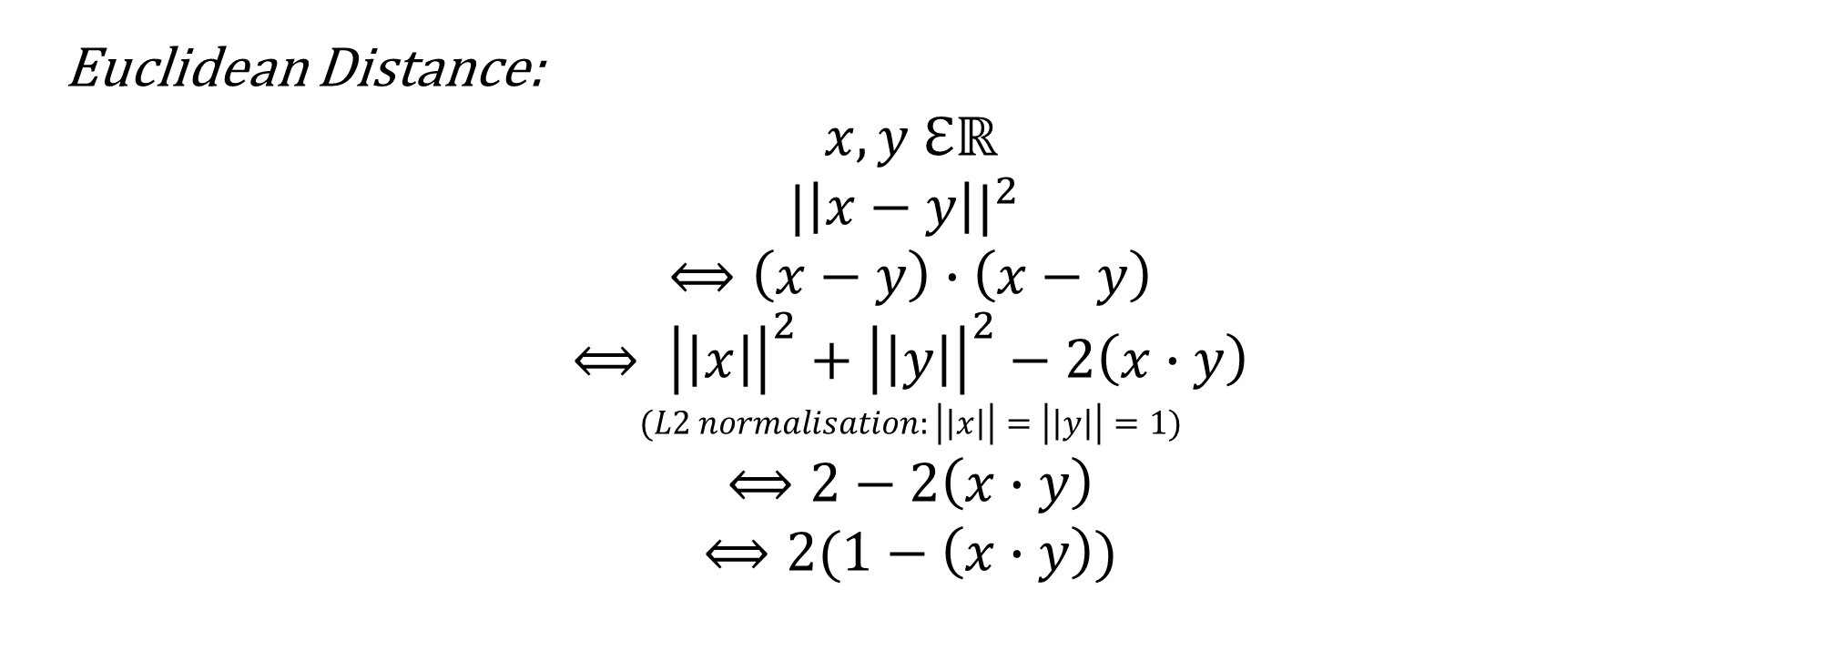
Euclidean Distance:
$$x,y ℇℝ$$
$${|\left|x−y\right||}^{2}$$
$$⟺\left(x−y\right)∙\left(x−y\right)$$
$$⟺ {\left|\left|x\right|\right|}^{2}+{\left|\left|y\right|\right|}^{2}−2\left(x∙y\right)$$
$$(L2 normalisation:\left|\left|x\right|\right|=\left|\left|y\right|\right|=1)$$
$$⟺2−2\left(x∙y\right)$$
$$⟺2(1−\left(x∙y\right))$$

Slide 22
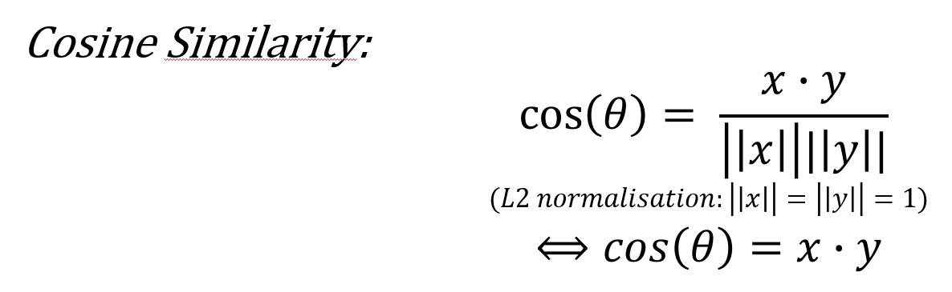

Slide 23
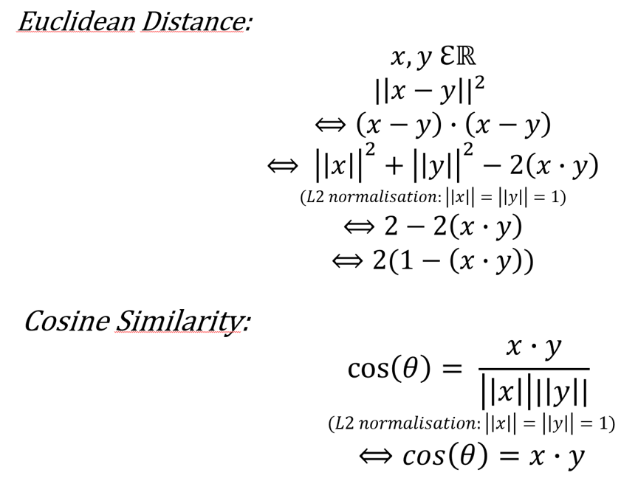
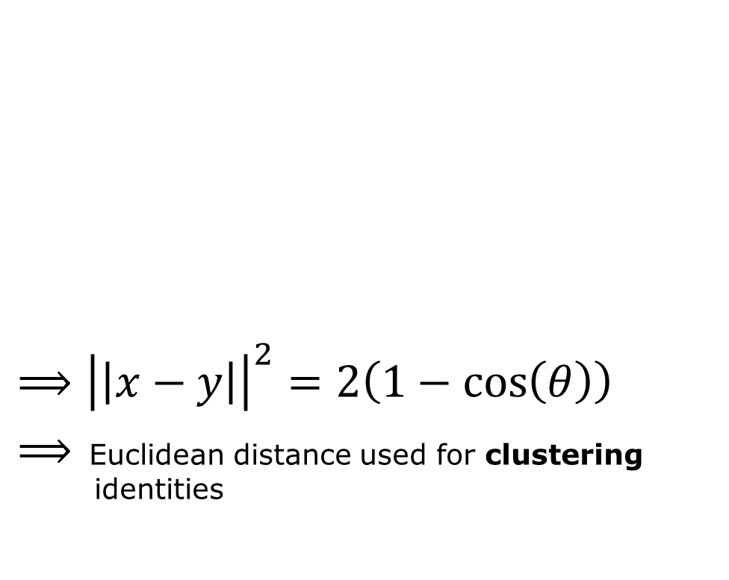
Euclidean distance in function of cosine similarity
$⟹{\left|\left|x−y\right|\right|}^{2}=2\left(1−\cos\left(θ\right)\right)$
$⟹$ Euclidean distance used for clustering aaaa identities

Slide 24
Selection of k

Slide 25
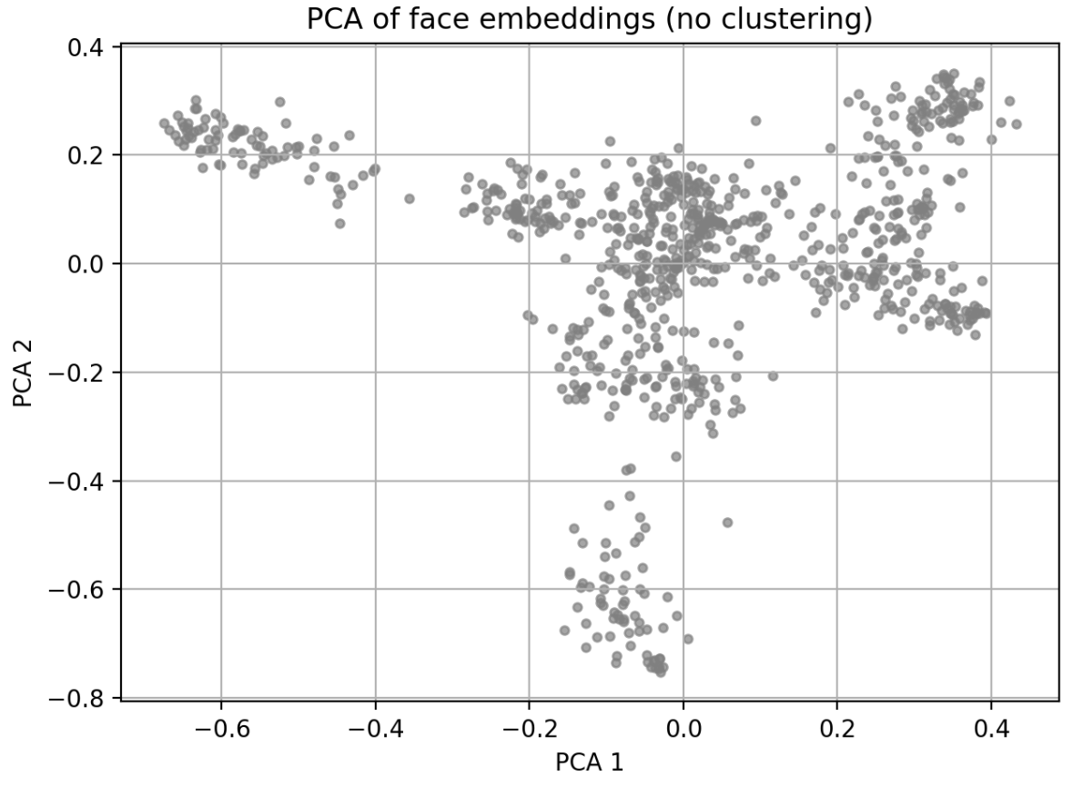

Slide 26
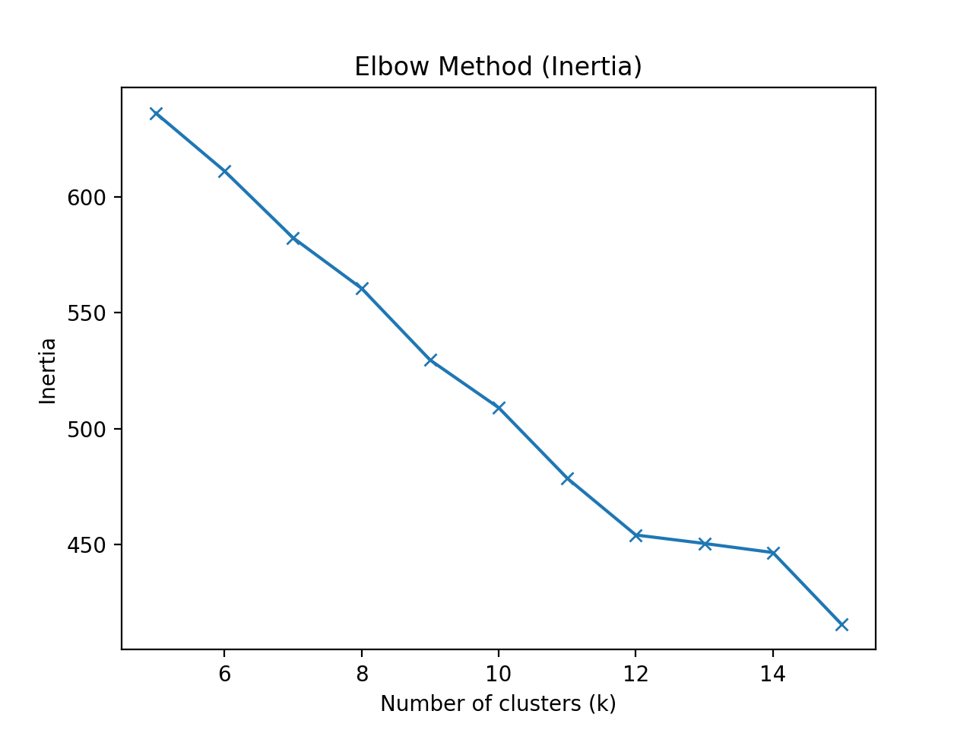
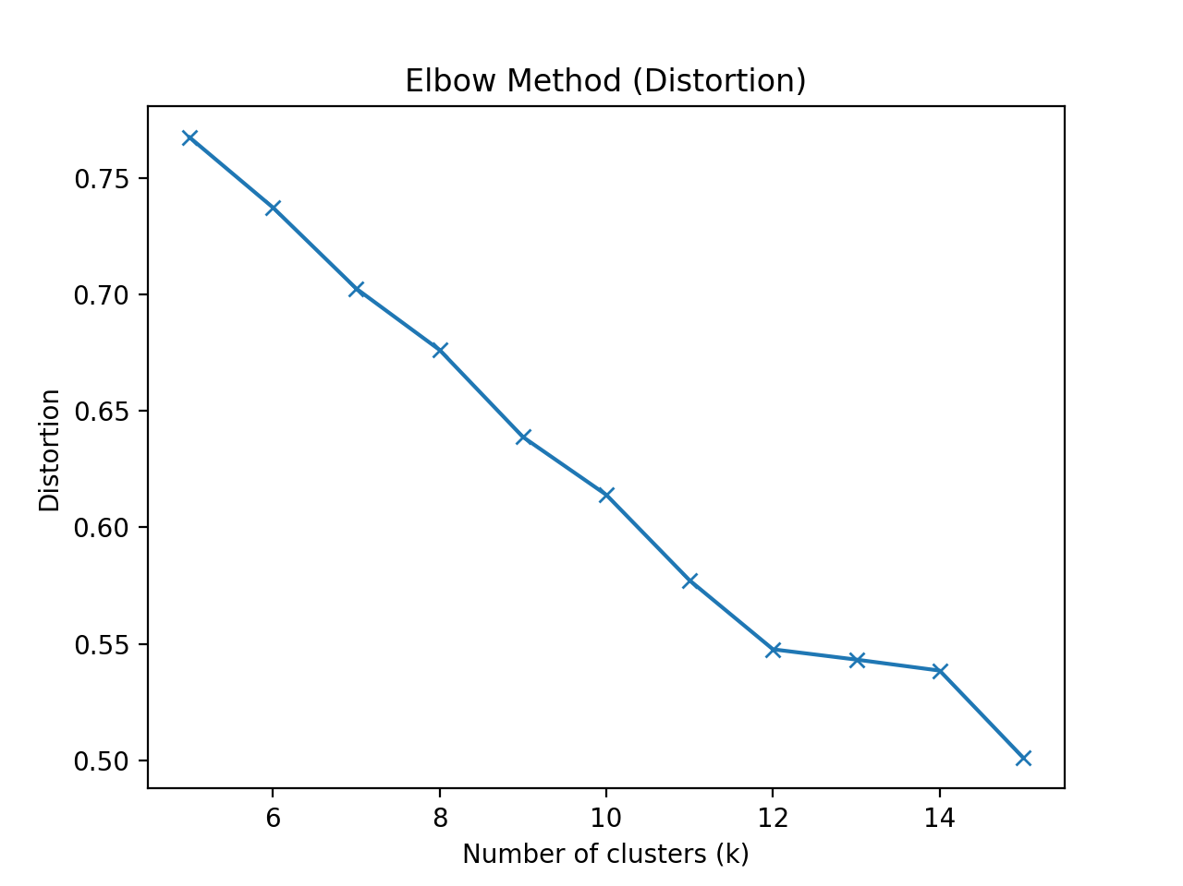
Elbow Method (Distortion)
Average squared distances between embeddings and their cluster
Lower distortion values = more compact clusters.

Slide 27
Elbow Method (Inertia)
Sum distance between embeddings and their centroids
Similar trend as distortion

Slide 28
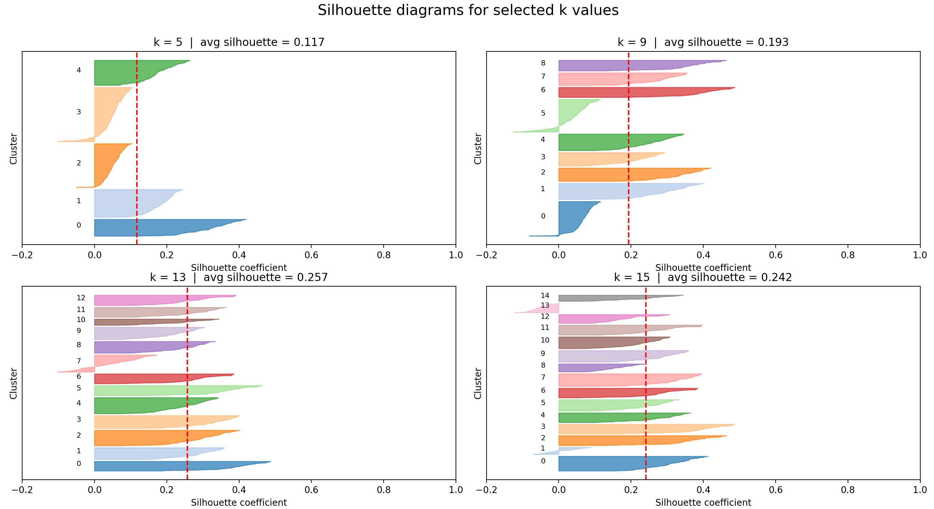
Silhouette scores
Measures cluster quality
Compares intra- vs inter-cluster similarity:
How close is point to assigned cluster?
How close is cluster to closest cluster?
Higher score = better quality

Slide 29
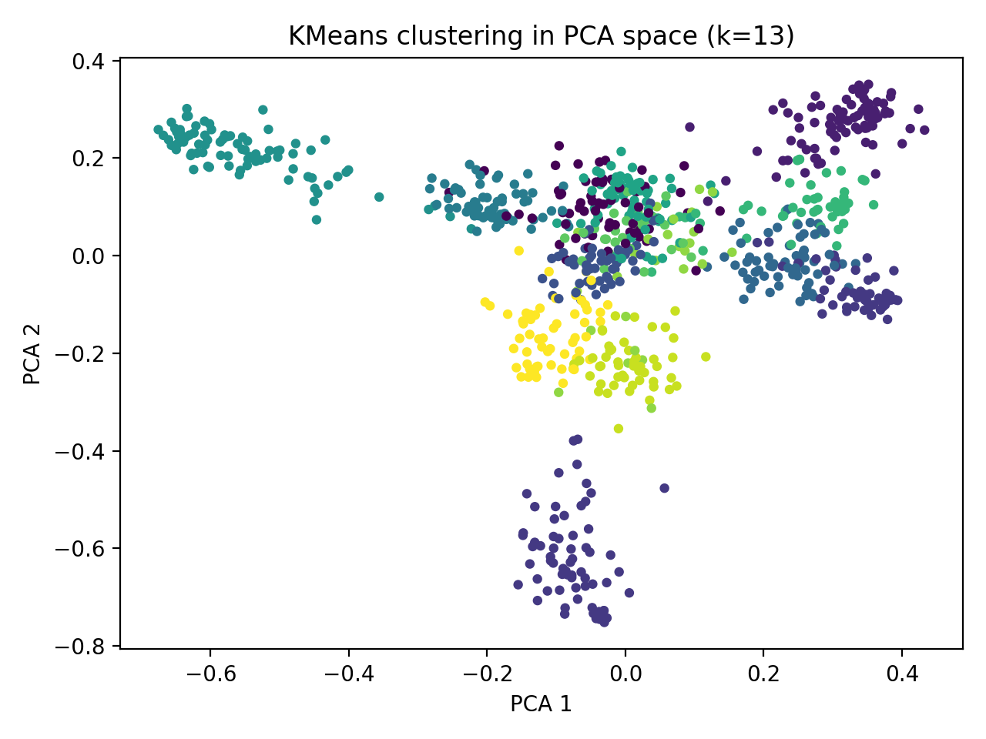
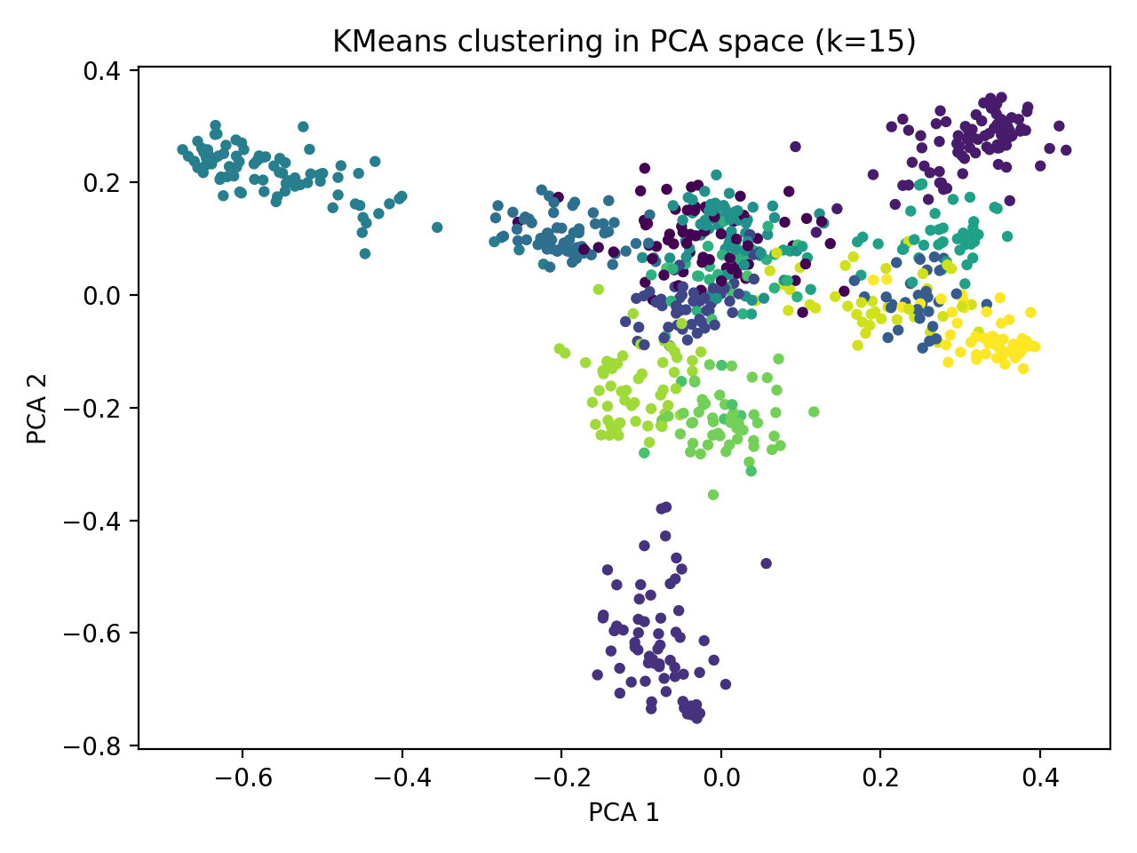
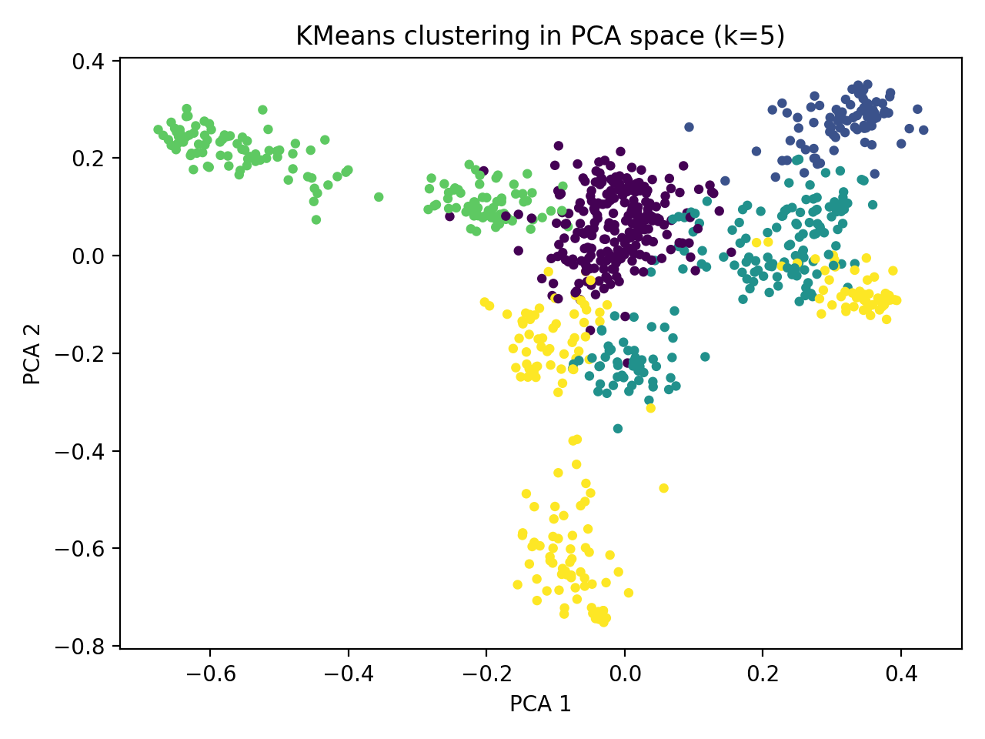

Slide 30
Clustering

Slide 31
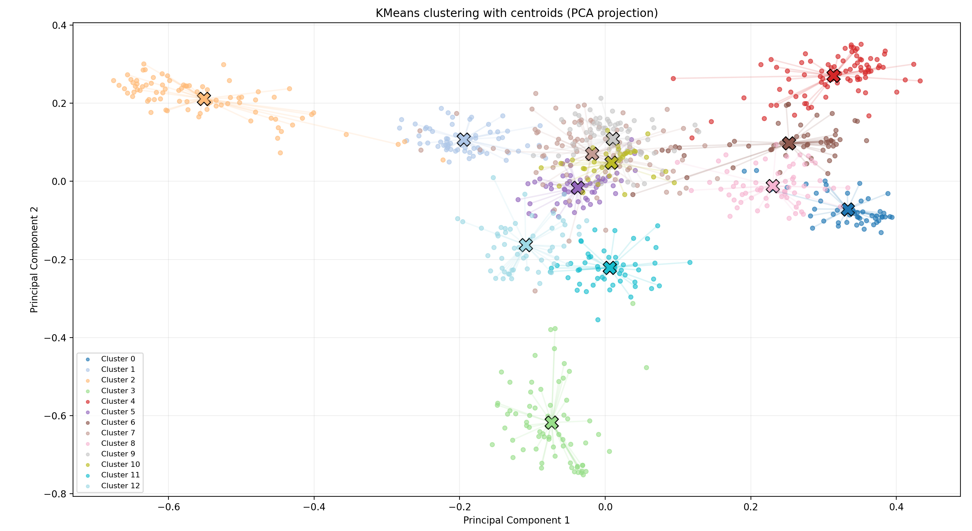
Kmeans clustering
Algorithm: Kmeans
Number of clusters: k = 13
Assigns embeddings to nearest centroid

Slide 32
Clustering workflow
Files column → list
Embedding column → list
2 lists: files[i] ↔ embeddings[i]
Kmeans predicts cluster label on embeddings list
→ 3 lists: files[i] ↔ embeddings[i] ↔ labels[i]
One folder created per cluster
Face copied to their cluster folder

Slide 33
Model training

Slide 34
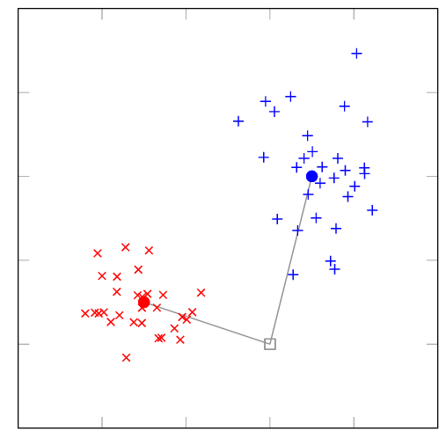
Centroid-based classifier
Centroid = mean embedding per identity
New embedding compared to centroid
→ closest centroid is selected

Slide 35
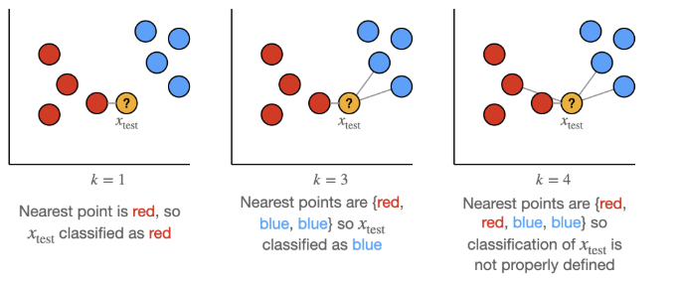
k-Nearest Neighbours
Compares embeddings
Prediction determined by votes

Slide 36
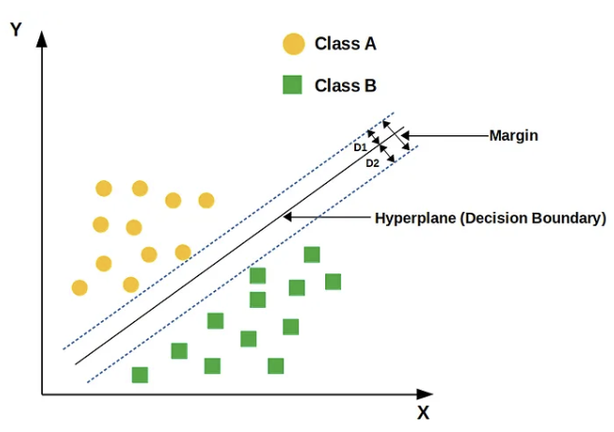
Support Vector Machine
Learns decision boundaries
Each class is separated by a hyperplane
Predicted identity = distance to the decision boundary and side

Slide 37
Logistic Regression
Probabilistic classifier
→ estimates probability embedding belongs to each identity
→ highest probability = the final prediction

Slide 38
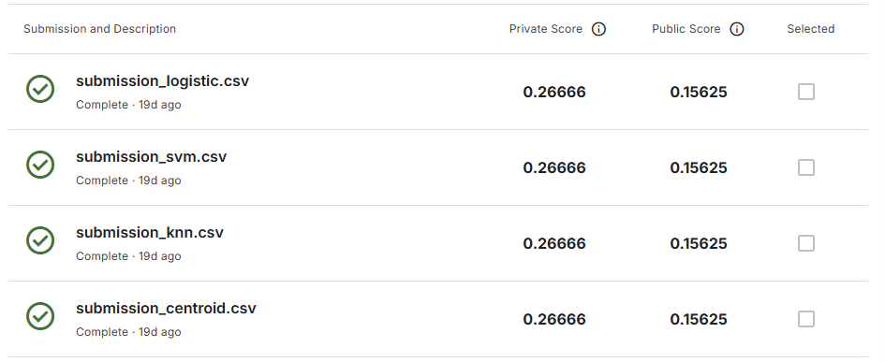

Slide 39
QUESTIONS?

